Slide 1
Floyd’s Algorithm and
Warshall’s Algorithm
Fall 2023

Slide 2
Overview and Due
Overview
  Floyd’s algorithm for finding costs of shortest paths
  Warshall’s algorithm for finding transitive closures
Schedule
  Final exam will be open all of finals week
  Project 5 hackathon is Wednesday
Due
  HW 6 due Wednesday
  Project 5a due Friday
  Other stuff due
  Project 5b due Thursday, Dec 14
    We can’t accept any late projects because of university policy

Slide 3
Five Graph Algorithms
Beginning with Floyd’s algorithm

Slide 4
Weighted Graph
1
1
8
2
6
2
3
5
1
3
4
4
Think of edge weights
as miles or minutes
between vertices
Compute shortest distances

Slide 5
Shortest Distance in a Weighted Graph
1
1
8
2
6
2
3
5
1
3
4
4
?
Minimum Dist[3,2] = ?
Minimum Dist[1,4] =

Slide 6
Shortest Distance in a Weighted Graph
1
1
8
2
6
2
3
5
1
3
4
4
6
Minimum Dist[3,2] =
Minimum Dist[1,4] =
∞

Slide 7
Floyd’s Algorithm
An O(n³) algorithm for finding the costs of shortest paths between all pairs of vertices
  But not the paths themselves
Floyd’s algorithm is found in the problems that follow section 10.6
Floyd’s algorithm is Algorithm 2 on page 752

Slide 8
Floyd’s Algorithm
An O(n³) algorithm for finding the costs of shortest paths between all pairs of vertices
  But not the paths themselves
Floyd’s algorithm is found in the problems that follow section 10.6
Floyd’s algorithm is Algorithm 2 on page 752
You’ll hear me say
“cost of least cost paths” and
“shortest distances”
My mind automatically treats costs as distances

Slide 9
Floyd’s Algorithm
Initialize
for k=1 to n
for i=1 to n
for j=1 to n
if d(v_{i},v_{j}) > d(v_{i},v_{k}) + d(v_{k},v_{j})
then d(v_{i},v_{j}) ← d(v_{i},v_{k}) + d(v_{k},v_{j})
Notes:
Point out that initial matrix is the edge weights or infinity.

Slide 10
Floyd’s Algorithm
You should have this algorithm on your final exam sheet of notes
Initialize
for k=1 to n
for i=1 to n
for j=1 to n
if d(v_{i},v_{j}) > d(v_{i},v_{k}) + d(v_{k},v_{j})
then d(v_{i},v_{j}) ← d(v_{i},v_{k}) + d(v_{k},v_{j})
Notes:
Point out that initial matrix is the edge weights or infinity.

Slide 11
Floyd’s Algorithm
Initialize
for k=1 to n
for i=1 to n
for j=1 to n
if d(v_{i},v_{j}) > d(v_{i},v_{k}) + d(v_{k},v_{j})
then d(v_{i},v_{j}) ← d(v_{i},v_{k}) + d(v_{k},v_{j})
1
1
8
2
6
2
3
5
1
3
4
4
Requires simple weighted graph
No self loops
Not multiple edges between vertices
Notes:
Point out that initial matrix is the edge weights or infinity.

Slide 12
Floyd’s Algorithm
Data Structure
Matrix of costs of paths between
row vertex and column vertex
Initialize
for k=1 to n
for i=1 to n
for j=1 to n
if d(v_{i},v_{j}) > d(v_{i},v_{k}) + d(v_{k},v_{j})
then d(v_{i},v_{j}) ← d(v_{i},v_{k}) + d(v_{k},v_{j})
1
1
8
2
6
2
3
5
1
3
4
4
 | 1 | 2 | 3 | 4 | 5
1 | 0 | 1 | ∞ | 8 | ∞
2 | ∞ | 0 | 2 | ∞ | 6
3 | ∞ | ∞ | 0 | 3 | 1
4 | ∞ | ∞ | 4 | 0 | ∞
5 | ∞ | ∞ | ∞ | ∞ | 0
Initial d(v_{i},v_{j}) =
Notes:
0s on the diagonal since you can get from vertex k to vertex k with zero cost

Slide 13
Floyd’s Algorithm
Data Structure
Matrix of costs of paths between
row vertex and column vertex
Initialize
for k=1 to n
for i=1 to n
for j=1 to n
if d(v_{i},v_{j}) > d(v_{i},v_{k}) + d(v_{k},v_{j})
then d(v_{i},v_{j}) ← d(v_{i},v_{k}) + d(v_{k},v_{j})
You should have be able to initialize this matrix for the final exam
 | 1 | 2 | 3 | 4 | 5
1 | 0 | 1 | ∞ | 8 | ∞
2 | ∞ | 0 | 2 | ∞ | 6
3 | ∞ | ∞ | 0 | 3 | 1
4 | ∞ | ∞ | 4 | 0 | ∞
5 | ∞ | ∞ | ∞ | ∞ | 0
Initial d(v_{i},v_{j}) =
Notes:
0s on the diagonal since you can get from vertex k to vertex k with zero cost

Slide 14
Floyd’s Algorithm
Data Structure
Matrix of costs of paths between
row vertex and column vertex
Initialize
for k=1 to n
for i=1 to n
for j=1 to n
if d(v_{i},v_{j}) > d(v_{i},v_{k}) + d(v_{k},v_{j})
then d(v_{i},v_{j}) ← d(v_{i},v_{k}) + d(v_{k},v_{j})
1
1
8
2
6
2
3
5
1
3
4
4
 | 1 | 2 | 3 | 4 | 5
1 | 0 | 1 | ∞ | 8 | ∞
2 | ∞ | 0 | 2 | ∞ | 6
3 | ∞ | ∞ | 0 | 3 | 1
4 | ∞ | ∞ | 4 | 0 | ∞
5 | ∞ | ∞ | ∞ | ∞ | 0
Requires simple weighted graph
No self loops
Not multiple edges between vertices
Initial d(v_{i},v_{j}) =
Zeros on the diagonal
Notes:
0s on the diagonal since you can get from vertex k to vertex k with zero cost

Slide 15
Floyd’s Algorithm
Data Structure
Matrix of costs of paths between
row vertex and column vertex
Initialize
for k=1 to n
for i=1 to n
for j=1 to n
if d(v_{i},v_{j}) > d(v_{i},v_{k}) + d(v_{k},v_{j})
then d(v_{i},v_{j}) ← d(v_{i},v_{k}) + d(v_{k},v_{j})
1
1
8
2
6
2
3
5
1
3
4
4
 | 1 | 2 | 3 | 4 | 5
1 | 0 | 1 | ∞ | 8 | ∞
2 | ∞ | 0 | 2 | ∞ | 6
3 | ∞ | ∞ | 0 | 3 | 1
4 | ∞ | ∞ | 4 | 0 | ∞
5 | ∞ | ∞ | ∞ | ∞ | 0
Initial d(v_{i},v_{j}) =
The initial matrix has the edge weights or infinity.
Notes:
Point out that initial matrix is the edge weights or infinity.

Slide 16
Floyd’s Algorithm
Data Structure
Matrix of costs of paths between
row vertex and column vertex
Initialize
for k=1 to n
for i=1 to n
for j=1 to n
if d(v_{i},v_{j}) > d(v_{i},v_{k}) + d(v_{k},v_{j})
then d(v_{i},v_{j}) ← d(v_{i},v_{k}) + d(v_{k},v_{j})
1
1
8
2
6
2
3
5
1
3
4
4
 | 1 | 2 | 3 | 4 | 5
1 | 0 | 1 | ∞ | 8 | ∞
2 | ∞ | 0 | 2 | ∞ | 6
3 | ∞ | ∞ | 0 | 3 | 1
4 | ∞ | ∞ | 4 | 0 | ∞
5 | ∞ | ∞ | ∞ | ∞ | 0
Initial d(v_{i},v_{j}) =
The initial matrix has the edge weights or infinity.
Notes:
Point out that initial matrix is the edge weights or infinity.

Slide 17
Floyd’s Algorithm
Data Structure
Matrix of costs of paths between
row vertex and column vertex
Initialize
for k=1 to n
for i=1 to n
for j=1 to n
if d(v_{i},v_{j}) > d(v_{i},v_{k}) + d(v_{k},v_{j})
then d(v_{i},v_{j}) ← d(v_{i},v_{k}) + d(v_{k},v_{j})
1
1
8
2
6
2
3
5
1
3
4
4
 | 1 | 2 | 3 | 4 | 5
1 | 0 | 1 | ∞ | 8 | ∞
2 | ∞ | 0 | 2 | ∞ | 6
3 | ∞ | ∞ | 0 | 3 | 1
4 | ∞ | ∞ | 4 | 0 | ∞
5 | ∞ | ∞ | ∞ | ∞ | 0
Initial d(v_{i},v_{j}) =
The initial matrix has the edge weights or infinity.
Notes:
Point out that initial matrix is the edge weights or infinity.

Slide 18
Floyd’s Algorithm
Data Structure
Matrix of costs of paths between
row vertex and column vertex
Initialize
for k=1 to n
for i=1 to n
for j=1 to n
if d(v_{i},v_{j}) > d(v_{i},v_{k}) + d(v_{k},v_{j})
then d(v_{i},v_{j}) ← d(v_{i},v_{k}) + d(v_{k},v_{j})
1
1
8
2
6
2
3
5
1
3
4
4
 | 1 | 2 | 3 | 4 | 5
1 | 0 | 1 | ∞ | 8 | ∞
2 | ∞ | 0 | 2 | ∞ | 6
3 | ∞ | ∞ | 0 | 3 | 1
4 | ∞ | ∞ | 4 | 0 | ∞
5 | ∞ | ∞ | ∞ | ∞ | 0
choose infinity so that greater than operator works
Initial d(v_{i},v_{j}) =
Notes:
Point out that initial matrix is the edge weights or infinity.

Slide 19
Floyd’s Algorithm
Initialize
for k=1 to n
for i=1 to n
for j=1 to n
if d(v_{i},v_{j}) > d(v_{i},v_{k}) + d(v_{k},v_{j})
then d(v_{i},v_{j}) ← d(v_{i},v_{k}) + d(v_{k},v_{j})
1
1
8
2
6
2
3
5
1
3
4
4
I changed the index names from the book so that they match what we’ll see in Warshall’s algorithm
Notes:
Point out that initial matrix is the edge weights or infinity.

Slide 20
Floyd’s Algorithm
Initialize
for k=1 to n
for i=1 to n
for j=1 to n
if d(v_{i},v_{j}) > d(v_{i},v_{k}) + d(v_{k},v_{j})
then d(v_{i},v_{j}) ← d(v_{i},v_{k}) + d(v_{k},v_{j})
1
1
8
2
6
2
3
5
1
3
4
4
Pivot vertex k
Notes:
Point out that initial matrix is the edge weights or infinity.

Slide 21
Floyd’s Algorithm
Initialize
for k=1 to n
for i=1 to n
for j=1 to n
if d(v_{i},v_{j}) > d(v_{i},v_{k}) + d(v_{k},v_{j})
then d(v_{i},v_{j}) ← d(v_{i},v_{k}) + d(v_{k},v_{j})
1
1
8
2
6
2
3
5
1
3
4
4
row vertex is where path starts
Notes:
Point out that initial matrix is the edge weights or infinity.

Slide 22
Floyd’s Algorithm
Initialize
for k=1 to n
for i=1 to n
for j=1 to n
if d(v_{i},v_{j}) > d(v_{i},v_{k}) + d(v_{k},v_{j})
then d(v_{i},v_{j}) ← d(v_{i},v_{k}) + d(v_{k},v_{j})
1
1
8
2
6
2
3
5
1
3
4
4
column vertex is where path ends
Notes:
Point out that initial matrix is the edge weights or infinity.

Slide 23
Floyd’s Algorithm
Initialize
for k=1 to n
for i=1 to n
for j=1 to n
if d(v_{i},v_{j}) > d(v_{i},v_{k}) + d(v_{k},v_{j})
then d(v_{i},v_{j}) ← d(v_{i},v_{k}) + d(v_{k},v_{j})
1
1
8
2
6
2
3
5
1
3
4
4
If cost of current shortest path between i and j
Notes:
Point out that initial matrix is the edge weights or infinity.

Slide 24
Floyd’s Algorithm
Initialize
for k=1 to n
for i=1 to n
for j=1 to n
if d(v_{i},v_{j}) > d(v_{i},v_{k}) + d(v_{k},v_{j})
then d(v_{i},v_{j}) ← d(v_{i},v_{k}) + d(v_{k},v_{j})
1
1
8
2
6
2
3
5
1
3
4
4
If cost of current shortest path between i and j
is longer than cumulative path through k
Notes:
Point out that initial matrix is the edge weights or infinity.

Slide 25
Floyd’s Algorithm
update distance from i to j
Initialize
for k=1 to n
for i=1 to n
for j=1 to n
if d(_{vi},_{vj}) > d(v_{i},v_{k}) + d(v_{k},v_{j})
then d(v_{i},v_{j}) ← d(v_{i},v_{k}) + d(v_{k},v_{j})
1
1
8
2
6
2
3
5
1
3
4
4
If cost of current shortest path between i and j
is longer than cumulative path through k
Notes:
Point out that initial matrix is the edge weights or infinity.

Slide 26
Floyd’s Algorithm (continued…)
Initialize
for k=1 to n
for i=1 to n
for j=1 to n
if d(v_{i},v_{j}) > d(v_{i},v_{k}) + d(v_{k},v_{j})
then d(v_{i},v_{j}) ← d(v_{i},v_{k}) + d(v_{k},v_{j})
1
1
8
2
6
2
3
5
1
3
4
4
Pivot k:
k=1: nothing
k=1:
 | 1 | 2 | 3 | 4 | 5
1 | 0 | 1 | ∞ | 8 | ∞
2 | ∞ | 0 | 2 | ∞ | 6
3 | ∞ | ∞ | 0 | 3 | 1
4 | ∞ | ∞ | 4 | 0 | ∞
5 | ∞ | ∞ | ∞ | ∞ | 0
k=1

Slide 27
Floyd’s Algorithm (continued…)
Initialize
for k=1 to n
for i=1 to n
for j=1 to n
if d(v_{i},v_{j}) > d(v_{i},v_{k}) + d(v_{k},v_{j})
then d(v_{i},v_{j}) ← d(v_{i},v_{k}) + d(v_{k},v_{j})
1
1
8
2
6
2
3
5
1
3
4
4
Pivot k:
k=1: nothing
k=1: Try to pivot through 1
 | 1 | 2 | 3 | 4 | 5
1 | 0 | 1 | ∞ | 8 | ∞
2 | ∞ | 0 | 2 | ∞ | 6
3 | ∞ | ∞ | 0 | 3 | 1
4 | ∞ | ∞ | 4 | 0 | ∞
5 | ∞ | ∞ | ∞ | ∞ | 0
k=1

Slide 28
Floyd’s Algorithm (continued…)
Initialize
for k=1 to n
for i=1 to n
for j=1 to n
if d(v_{i},v_{j}) > d(v_{i},v_{k}) + d(v_{k},v_{j})
then d(v_{i},v_{j}) ← d(v_{i},v_{k}) + d(v_{k},v_{j})
1
1
8
2
6
2
3
5
1
3
4
4
Pivot k:
k=1: nothing
k=1: Try to pivot through 1
No arrows point to 1 so
 | 1 | 2 | 3 | 4 | 5
1 | 0 | 1 | ∞ | 8 | ∞
2 | ∞ | 0 | 2 | ∞ | 6
3 | ∞ | ∞ | 0 | 3 | 1
4 | ∞ | ∞ | 4 | 0 | ∞
5 | ∞ | ∞ | ∞ | ∞ | 0
k=1

Slide 29
Floyd’s Algorithm (continued…)
Initialize
for k=1 to n
for i=1 to n
for j=1 to n
if d(v_{i},v_{j}) > d(v_{i},v_{k}) + d(v_{k},v_{j})
then d(v_{i},v_{j}) ← d(v_{i},v_{k}) + d(v_{k},v_{j})
1
1
8
2
6
2
3
5
1
3
4
4
Pivot k:
k=1: nothing
k=1: Try to pivot through 1
No arrows point to 1 so
you can’t pivot through 1 so
 | 1 | 2 | 3 | 4 | 5
1 | 0 | 1 | ∞ | 8 | ∞
2 | ∞ | 0 | 2 | ∞ | 6
3 | ∞ | ∞ | 0 | 3 | 1
4 | ∞ | ∞ | 4 | 0 | ∞
5 | ∞ | ∞ | ∞ | ∞ | 0
k=1

Slide 30
Floyd’s Algorithm (continued…)
Initialize
for k=1 to n
for i=1 to n
for j=1 to n
if d(v_{i},v_{j}) > d(v_{i},v_{k}) + d(v_{k},v_{j})
then d(v_{i},v_{j}) ← d(v_{i},v_{k}) + d(v_{k},v_{j})
1
1
8
2
6
2
3
5
1
3
4
4
Pivot k:
k=1: nothing
k=1: Try to pivot through 1
No arrows point to 1 so
you can’t pivot through 1 so
d(v_{i},v₁) = ∞ so
 | 1 | 2 | 3 | 4 | 5
1 | 0 | 1 | ∞ | 8 | ∞
2 | ∞ | 0 | 2 | ∞ | 6
3 | ∞ | ∞ | 0 | 3 | 1
4 | ∞ | ∞ | 4 | 0 | ∞
5 | ∞ | ∞ | ∞ | ∞ | 0
k=1

Slide 31
Floyd’s Algorithm (continued…)
Initialize
for k=1 to n
for i=1 to n
for j=1 to n
if d(v_{i},v_{j}) > d(v_{i},v_{k}) + d(v_{k},v_{j})
then d(v_{i},v_{j}) ← d(v_{i},v_{k}) + d(v_{k},v_{j})
1
1
8
2
6
2
3
5
1
3
4
4
Pivot k:
k=1: nothing
k=1: Try to pivot through 1
No arrows point to 1 so
you can’t pivot through 1 so
d(v_{i},v₁) = ∞ so
no updates occur
 | 1 | 2 | 3 | 4 | 5
1 | 0 | 1 | ∞ | 8 | ∞
2 | ∞ | 0 | 2 | ∞ | 6
3 | ∞ | ∞ | 0 | 3 | 1
4 | ∞ | ∞ | 4 | 0 | ∞
5 | ∞ | ∞ | ∞ | ∞ | 0
k=1

Slide 32
Floyd’s Algorithm (continued…)
Initialize
for k=1 to n
for i=1 to n
for j=1 to n
if d(v_{i},v_{j}) > d(v_{i},v_{k}) + d(v_{k},v_{j})
then d(v_{i},v_{j}) ← d(v_{i},v_{k}) + d(v_{k},v_{j})
1
1
8
2
6
2
3
5
1
3
4
4
Pivot k:
k=1: nothing
k=1: Try to pivot through 1
No arrows point to 1 so
you can’t pivot through 1 so
d(v_{i},v₁) = ∞ so
no updates occur
 | 1 | 2 | 3 | 4 | 5
1 | 0 | 1 | ∞ | 8 | ∞
2 | ∞ | 0 | 2 | ∞ | 6
3 | ∞ | ∞ | 0 | 3 | 1
4 | ∞ | ∞ | 4 | 0 | ∞
5 | ∞ | ∞ | ∞ | ∞ | 0
 | 1 | 2 | 3 | 4 | 5
1 | 0 | 1 | ∞ | 8 | ∞
2 | ∞ | 0 | 2 | ∞ | 6
3 | ∞ | ∞ | 0 | 3 | 1
4 | ∞ | ∞ | 4 | 0 | ∞
5 | ∞ | ∞ | ∞ | ∞ | 0
After
initialization
After k=1
iteration

Slide 33
Floyd’s Algorithm (continued…)
Initialize
for k=1 to n
for i=1 to n
for j=1 to n
if d(v_{i},v_{j}) > d(v_{i},v_{k}) + d(v_{k},v_{j})
then d(v_{i},v_{j}) ← d(v_{i},v_{k}) + d(v_{k},v_{j})
1
1
8
2
6
2
3
5
1
3
4
4
Pivot k:
k=1: nothing
 | 1 | 2 | 3 | 4 | 5
1 | 0 | 1 | ∞ | 8 | ∞
2 | ∞ | 0 | 2 | ∞ | 6
3 | ∞ | ∞ | 0 | 3 | 1
4 | ∞ | ∞ | 4 | 0 | ∞
5 | ∞ | ∞ | ∞ | ∞ | 0
k=2: i=1, j=1
Can I travel from i to j through k?
Current estimates

Slide 34
Floyd’s Algorithm (continued…)
Initialize
for k=1 to n
for i=1 to n
for j=1 to n
if d(v_{i},v_{j}) > d(v_{i},v_{k}) + d(v_{k},v_{j})
then d(v_{i},v_{j}) ← d(v_{i},v_{k}) + d(v_{k},v_{j})
1
1
8
2
6
2
3
5
1
3
4
4
Pivot k:
k=1: nothing
 | 1 | 2 | 3 | 4 | 5
1 | 0 | 1 | ∞ | 8 | ∞
2 | ∞ | 0 | 2 | ∞ | 6
3 | ∞ | ∞ | 0 | 3 | 1
4 | ∞ | ∞ | 4 | 0 | ∞
5 | ∞ | ∞ | ∞ | ∞ | 0
k=2: i=1, j=1, nothing
Can I travel from i to j through k?
Current estimates

Slide 35
Floyd’s Algorithm (continued…)
Initialize
for k=1 to n
for i=1 to n
for j=1 to n
if d(v_{i},v_{j}) > d(v_{i},v_{k}) + d(v_{k},v_{j})
then d(v_{i},v_{j}) ← d(v_{i},v_{k}) + d(v_{k},v_{j})
1
1
8
2
6
2
3
5
1
3
4
4
Pivot k:
k=1: nothing
 | 1 | 2 | 3 | 4 | 5
1 | 0 | 1 | ∞ | 8 | ∞
2 | ∞ | 0 | 2 | ∞ | 6
3 | ∞ | ∞ | 0 | 3 | 1
4 | ∞ | ∞ | 4 | 0 | ∞
5 | ∞ | ∞ | ∞ | ∞ | 0
k=2: i=1, j=2
Can I travel from i to j through k?
Current estimates

Slide 36
Floyd’s Algorithm (continued…)
Initialize
for k=1 to n
for i=1 to n
for j=1 to n
if d(v_{i},v_{j}) > d(v_{i},v_{k}) + d(v_{k},v_{j})
then d(v_{i},v_{j}) ← d(v_{i},v_{k}) + d(v_{k},v_{j})
1
1
8
2
6
2
3
5
1
3
4
4
Pivot k:
k=1: nothing
 | 1 | 2 | 3 | 4 | 5
1 | 0 | 1 | ∞ | 8 | ∞
2 | ∞ | 0 | 2 | ∞ | 6
3 | ∞ | ∞ | 0 | 3 | 1
4 | ∞ | ∞ | 4 | 0 | ∞
5 | ∞ | ∞ | ∞ | ∞ | 0
k=2: i=1, j=2, nothing
Can I travel from i to j through k?
Current estimates

Slide 37
Floyd’s Algorithm (continued…)
Initialize
for k=1 to n
for i=1 to n
for j=1 to n
if d(v_{i},v_{j}) > d(v_{i},v_{k}) + d(v_{k},v_{j})
then d(v_{i},v_{j}) ← d(v_{i},v_{k}) + d(v_{k},v_{j})
1
1
8
2
6
2
3
5
1
3
4
4
Pivot k:
k=1: nothing
 | 1 | 2 | 3 | 4 | 5
1 | 0 | 1 | ∞ | 8 | ∞
2 | ∞ | 0 | 2 | ∞ | 6
3 | ∞ | ∞ | 0 | 3 | 1
4 | ∞ | ∞ | 4 | 0 | ∞
5 | ∞ | ∞ | ∞ | ∞ | 0
 | 1 | 2 | 3 | 4 | 5
1 | 0 | 1 | ? | 8 | ∞
2 | ∞ | 0 | 2 | ∞ | 6
3 | ∞ | ∞ | 0 | 3 | 1
4 | ∞ | ∞ | 4 | 0 | ∞
5 | ∞ | ∞ | ∞ | ∞ | 0
k=2: i=1, j=3
Can I travel from i to j through k?
Current estimates
i→j element (1,3)

Slide 38
Floyd’s Algorithm (continued…)
Initialize
for k=1 to n
for i=1 to n
for j=1 to n
if d(v_{i},v_{j}) > d(v_{i},v_{k}) + d(v_{k},v_{j})
then d(v_{i},v_{j}) ← d(v_{i},v_{k}) + d(v_{k},v_{j})
1
1
8
2
6
2
3
5
1
3
4
4
Pivot k:
k=1: nothing
 | 1 | 2 | 3 | 4 | 5
1 | 0 | 1 | ∞ | 8 | ∞
2 | ∞ | 0 | 2 | ∞ | 6
3 | ∞ | ∞ | 0 | 3 | 1
4 | ∞ | ∞ | 4 | 0 | ∞
5 | ∞ | ∞ | ∞ | ∞ | 0
 | 1 | 2 | 3 | 4 | 5
1 | 0 | 1 | ? | 8 | ∞
2 | ∞ | 0 | 2 | ∞ | 6
3 | ∞ | ∞ | 0 | 3 | 1
4 | ∞ | ∞ | 4 | 0 | ∞
5 | ∞ | ∞ | ∞ | ∞ | 0
k=2: i=1, j=3
if d(v_{i},v_{j}) > d(v_{i},v_{k}) + d(v_{k},v_{j})
if ∞ > ? + ?
Can I travel from i to j through k?
Current estimates
i→j element (1,3)

Slide 39
Floyd’s Algorithm (continued…)
Initialize
for k=1 to n
for i=1 to n
for j=1 to n
if d(v_{i},v_{j}) > d(v_{i},v_{k}) + d(v_{k},v_{j})
then d(v_{i},v_{j}) ← d(v_{i},v_{k}) + d(v_{k},v_{j})
1
1
8
2
6
2
3
5
1
3
4
4
Pivot k:
k=1: nothing
 | 1 | 2 | 3 | 4 | 5
1 | 0 | 1 | ∞ | 8 | ∞
2 | ∞ | 0 | 2 | ∞ | 6
3 | ∞ | ∞ | 0 | 3 | 1
4 | ∞ | ∞ | 4 | 0 | ∞
5 | ∞ | ∞ | ∞ | ∞ | 0
 | 1 | 2 | 3 | 4 | 5
1 | 0 | 1 | ? | 8 | ∞
2 | ∞ | 0 | 2 | ∞ | 6
3 | ∞ | ∞ | 0 | 3 | 1
4 | ∞ | ∞ | 4 | 0 | ∞
5 | ∞ | ∞ | ∞ | ∞ | 0
k=2: i=1, j=3
if d(v_{i},v_{j}) > d(v_{i},v_{k}) + d(v_{k},v_{j})
if ∞ > 1 + ?
Can I travel from i to j through k?
i to k
Current estimates
i→j element (1,3)
i→k element (1,2)

Slide 40
Floyd’s Algorithm (continued…)
Initialize
for k=1 to n
for i=1 to n
for j=1 to n
if d(v_{i},v_{j}) > d(v_{i},v_{k}) + d(v_{k},v_{j})
then d(v_{i},v_{j}) ← d(v_{i},v_{k}) + d(v_{k},v_{j})
1
1
8
2
6
2
3
5
1
3
4
4
Pivot k:
k=1: nothing
 | 1 | 2 | 3 | 4 | 5
1 | 0 | 1 | ∞ | 8 | ∞
2 | ∞ | 0 | 2 | ∞ | 6
3 | ∞ | ∞ | 0 | 3 | 1
4 | ∞ | ∞ | 4 | 0 | ∞
5 | ∞ | ∞ | ∞ | ∞ | 0
 | 1 | 2 | 3 | 4 | 5
1 | 0 | 1 | ? | 8 | ∞
2 | ∞ | 0 | 2 | ∞ | 6
3 | ∞ | ∞ | 0 | 3 | 1
4 | ∞ | ∞ | 4 | 0 | ∞
5 | ∞ | ∞ | ∞ | ∞ | 0
k=2: i=1, j=3
if d(v_{i},v_{j}) > d(v_{i},v_{k}) + d(v_{k},v_{j})
if ∞ > 1 + 2
Can I travel from i to j through k?
i to k
k to j
Current estimates
i→j element (1,3)
i→k element (1,2)
k→j element (2,3)

Slide 41
Floyd’s Algorithm (continued…)
Initialize
for k=1 to n
for i=1 to n
for j=1 to n
if d(v_{i},v_{j}) > d(v_{i},v_{k}) + d(v_{k},v_{j})
then d(v_{i},v_{j}) ← d(v_{i},v_{k}) + d(v_{k},v_{j})
1
1
8
2
6
2
3
5
1
3
4
4
Pivot k:
k=1: nothing
 | 1 | 2 | 3 | 4 | 5
1 | 0 | 1 | ∞ | 8 | ∞
2 | ∞ | 0 | 2 | ∞ | 6
3 | ∞ | ∞ | 0 | 3 | 1
4 | ∞ | ∞ | 4 | 0 | ∞
5 | ∞ | ∞ | ∞ | ∞ | 0
 | 1 | 2 | 3 | 4 | 5
1 | 0 | 1 | ? | 8 | ∞
2 | ∞ | 0 | 2 | ∞ | 6
3 | ∞ | ∞ | 0 | 3 | 1
4 | ∞ | ∞ | 4 | 0 | ∞
5 | ∞ | ∞ | ∞ | ∞ | 0
k=2: i=1, j=3
if d(v_{i},v_{j}) > d(v_{i},v_{k}) + d(v_{k},v_{j})
if ∞ > 1 + 2
d(v_{i},v_{j}) ← d(v_{i},v_{k}) + d(v_{k},v_{j}) = 3
Can I travel from i to j through k?
Current estimates
i→j element (1,3)
i→k element (1,2)
k→j element (2,3)

Slide 42
Floyd’s Algorithm (continued…)
Initialize
for k=1 to n
for i=1 to n
for j=1 to n
if d(v_{i},v_{j}) > d(v_{i},v_{k}) + d(v_{k},v_{j})
then d(v_{i},v_{j}) ← d(v_{i},v_{k}) + d(v_{k},v_{j})
1
1
8
2
6
2
3
5
1
3
4
4
Pivot k:
k=1: nothing
 | 1 | 2 | 3 | 4 | 5
1 | 0 | 1 | ∞ | 8 | ∞
2 | ∞ | 0 | 2 | ∞ | 6
3 | ∞ | ∞ | 0 | 3 | 1
4 | ∞ | ∞ | 4 | 0 | ∞
5 | ∞ | ∞ | ∞ | ∞ | 0
 | 1 | 2 | 3 | 4 | 5
1 | 0 | 1 | 3 | 8 | ∞
2 | ∞ | 0 | 2 | ∞ | 6
3 | ∞ | ∞ | 0 | 3 | 1
4 | ∞ | ∞ | 4 | 0 | ∞
5 | ∞ | ∞ | ∞ | ∞ | 0
k=2: i=1, j=3
if d(v_{i},v_{j}) > d(v_{i},v_{k}) + d(v_{k},v_{j})
if ∞ > 1 + 2
d(v_{i},v_{j}) ← d(v_{i},v_{k}) + d(v_{k},v_{j}) = 3
Can I travel from i to j through k?
Current estimates
i→j element (1,3)
i→k element (1,2)
k→j element (2,3)

Slide 43
Floyd’s Algorithm (continued…)
Initialize
for k=1 to n
for i=1 to n
for j=1 to n
if d(v_{i},v_{j}) > d(v_{i},v_{k}) + d(v_{k},v_{j})
then d(v_{i},v_{j}) ← d(v_{i},v_{k}) + d(v_{k},v_{j})
1
1
8
2
6
2
3
5
1
3
4
4
Pivot k:
k=1: nothing
 | 1 | 2 | 3 | 4 | 5
1 | 0 | 1 | 3 | 8 | ∞
2 | ∞ | 0 | 2 | ∞ | 6
3 | ∞ | ∞ | 0 | 3 | 1
4 | ∞ | ∞ | 4 | 0 | ∞
5 | ∞ | ∞ | ∞ | ∞ | 0
k=2: 1→3:3
Can I travel from i to j through k?
Current estimates

Slide 44
Floyd’s Algorithm (continued…)
Initialize
for k=1 to n
for i=1 to n
for j=1 to n
if d(v_{i},v_{j}) > d(v_{i},v_{k}) + d(v_{k},v_{j})
then d(v_{i},v_{j}) ← d(v_{i},v_{k}) + d(v_{k},v_{j})
1
1
8
2
6
2
3
5
1
3
4
4
Pivot k:
k=1: nothing
 | 1 | 2 | 3 | 4 | 5
1 | 0 | 1 | 3 | 8 | ∞
2 | ∞ | 0 | 2 | ∞ | 6
3 | ∞ | ∞ | 0 | 3 | 1
4 | ∞ | ∞ | 4 | 0 | ∞
5 | ∞ | ∞ | ∞ | ∞ | 0
k=2: 1→3:3, 1→4:?
Can I travel from i to j through k?
Current estimates

Slide 45
Floyd’s Algorithm (continued…)
Initialize
for k=1 to n
for i=1 to n
for j=1 to n
if d(v_{i},v_{j}) > d(v_{i},v_{k}) + d(v_{k},v_{j})
then d(v_{i},v_{j}) ← d(v_{i},v_{k}) + d(v_{k},v_{j})
1
1
8
2
6
2
3
5
1
3
4
4
Pivot k:
k=1: nothing
 | 1 | 2 | 3 | 4 | 5
1 | 0 | 1 | 3 | 8 | ∞
2 | ∞ | 0 | 2 | ∞ | 6
3 | ∞ | ∞ | 0 | 3 | 1
4 | ∞ | ∞ | 4 | 0 | ∞
5 | ∞ | ∞ | ∞ | ∞ | 0
k=2: 1→3:3, 1→4:nothing
Can I travel from i to j through k?
Current estimates

Slide 46
Floyd’s Algorithm (continued…)
Initialize
for k=1 to n
for i=1 to n
for j=1 to n
if d(v_{i},v_{j}) > d(v_{i},v_{k}) + d(v_{k},v_{j})
then d(v_{i},v_{j}) ← d(v_{i},v_{k}) + d(v_{k},v_{j})
1
1
8
2
6
2
3
5
1
3
4
4
Pivot k:
k=1: nothing
 | 1 | 2 | 3 | 4 | 5
1 | 0 | 1 | 3 | 8 | ∞
2 | ∞ | 0 | 2 | ∞ | 6
3 | ∞ | ∞ | 0 | 3 | 1
4 | ∞ | ∞ | 4 | 0 | ∞
5 | ∞ | ∞ | ∞ | ∞ | 0
k=2: 1→3:3, 1→5:?
Can I travel from i to j through k?
Current estimates

Slide 47
Floyd’s Algorithm (continued…)
Initialize
for k=1 to n
for i=1 to n
for j=1 to n
if d(v_{i},v_{j}) > d(v_{i},v_{k}) + d(v_{k},v_{j})
then d(v_{i},v_{j}) ← d(v_{i},v_{k}) + d(v_{k},v_{j})
1
1
8
2
6
2
3
5
1
3
4
4
Pivot k:
k=1: nothing
 | 1 | 2 | 3 | 4 | 5
1 | 0 | 1 | 3 | 8 | ∞
2 | ∞ | 0 | 2 | ∞ | 6
3 | ∞ | ∞ | 0 | 3 | 1
4 | ∞ | ∞ | 4 | 0 | ∞
5 | ∞ | ∞ | ∞ | ∞ | 0
 | 1 | 2 | 3 | 4 | 5
1 | 0 | 1 | 3 | 8 | ?
2 | ∞ | 0 | 2 | ∞ | 6
3 | ∞ | ∞ | 0 | 3 | 1
4 | ∞ | ∞ | 4 | 0 | ∞
5 | ∞ | ∞ | ∞ | ∞ | 0
k=2: 1→3:3, 1→5:?
Can I travel from i to j through k?
Current estimates
New estimate

Slide 48
Floyd’s Algorithm (continued…)
Initialize
for k=1 to n
for i=1 to n
for j=1 to n
if d(v_{i},v_{j}) > d(v_{i},v_{k}) + d(v_{k},v_{j})
then d(v_{i},v_{j}) ← d(v_{i},v_{k}) + d(v_{k},v_{j})
1
1
8
2
6
2
3
5
1
3
4
4
Pivot k:
k=1: nothing
 | 1 | 2 | 3 | 4 | 5
1 | 0 | 1 | 3 | 8 | ∞
2 | ∞ | 0 | 2 | ∞ | 6
3 | ∞ | ∞ | 0 | 3 | 1
4 | ∞ | ∞ | 4 | 0 | ∞
5 | ∞ | ∞ | ∞ | ∞ | 0
 | 1 | 2 | 3 | 4 | 5
1 | 0 | 1 | 3 | 8 | 7
2 | ∞ | 0 | 2 | ∞ | 6
3 | ∞ | ∞ | 0 | 3 | 1
4 | ∞ | ∞ | 4 | 0 | ∞
5 | ∞ | ∞ | ∞ | ∞ | 0
k=2: 1→3:3, 1→5:7
Can I travel from i to j through k?
Current estimates
New estimate

Slide 49
Floyd’s Algorithm (continued…)
Initialize
for k=1 to n
for i=1 to n
for j=1 to n
if d(v_{i},v_{j}) > d(v_{i},v_{k}) + d(v_{k},v_{j})
then d(v_{i},v_{j}) ← d(v_{i},v_{k}) + d(v_{k},v_{j})
1
1
8
2
6
2
3
5
1
3
4
4
Pivot k:
k=1: nothing
 | 1 | 2 | 3 | 4 | 5
1 | 0 | 1 | 3 | 8 | 7
2 | ∞ | 0 | 2 | ∞ | 6
3 | ∞ | ∞ | 0 | 3 | 1
4 | ∞ | ∞ | 4 | 0 | ∞
5 | ∞ | ∞ | ∞ | ∞ | 0
k=2: 1→3:3, 1→5:7
k=3:
Can I travel from i to j through k?
Current estimates

Slide 50
Floyd’s Algorithm (continued…)
Initialize
for k=1 to n
for i=1 to n
for j=1 to n
if d(v_{i},v_{j}) > d(v_{i},v_{k}) + d(v_{k},v_{j})
then d(v_{i},v_{j}) ← d(v_{i},v_{k}) + d(v_{k},v_{j})
1
1
8
2
6
2
3
5
1
3
4
4
Pivot k:
k=1: nothing
 | 1 | 2 | 3 | 4 | 5
1 | 0 | 1 | 3 | 8 | 7
2 | ∞ | 0 | 2 | ∞ | 6
3 | ∞ | ∞ | 0 | 3 | 1
4 | ∞ | ∞ | 4 | 0 | ∞
5 | ∞ | ∞ | ∞ | ∞ | 0
 | 1 | 2 | 3 | 4 | 5
1 | 0 | 1 | 3 | ? | 7
2 | ∞ | 0 | 2 | ∞ | 6
3 | ∞ | ∞ | 0 | 3 | 1
4 | ∞ | ∞ | 4 | 0 | ∞
5 | ∞ | ∞ | ∞ | ∞ | 0
k=2: 1→3:3, 1→5:7
k=3: 1→4:1→3+3→4:6
Current estimates
New estimates

Slide 51
Floyd’s Algorithm (continued…)
Initialize
for k=1 to n
for i=1 to n
for j=1 to n
if d(v_{i},v_{j}) > d(v_{i},v_{k}) + d(v_{k},v_{j})
then d(v_{i},v_{j}) ← d(v_{i},v_{k}) + d(v_{k},v_{j})
1
1
8
2
6
2
3
5
1
3
4
4
Pivot k:
k=1: nothing
 | 1 | 2 | 3 | 4 | 5
1 | 0 | 1 | 3 | 8 | 7
2 | ∞ | 0 | 2 | ∞ | 6
3 | ∞ | ∞ | 0 | 3 | 1
4 | ∞ | ∞ | 4 | 0 | ∞
5 | ∞ | ∞ | ∞ | ∞ | 0
 | 1 | 2 | 3 | 4 | 5
1 | 0 | 1 | 3 | ? | 7
2 | ∞ | 0 | 2 | ∞ | 6
3 | ∞ | ∞ | 0 | 3 | 1
4 | ∞ | ∞ | 4 | 0 | ∞
5 | ∞ | ∞ | ∞ | ∞ | 0
k=2: 1→3:3, 1→5:7
k=3: 1→4:1→3+3→4:6
Current estimates
New estimates

Slide 52
Floyd’s Algorithm (continued…)
Initialize
for k=1 to n
for i=1 to n
for j=1 to n
if d(v_{i},v_{j}) > d(v_{i},v_{k}) + d(v_{k},v_{j})
then d(v_{i},v_{j}) ← d(v_{i},v_{k}) + d(v_{k},v_{j})
1
1
8
2
6
2
3
5
1
3
4
4
Pivot k:
k=1: nothing
 | 1 | 2 | 3 | 4 | 5
1 | 0 | 1 | 3 | 8 | 7
2 | ∞ | 0 | 2 | ∞ | 6
3 | ∞ | ∞ | 0 | 3 | 1
4 | ∞ | ∞ | 4 | 0 | ∞
5 | ∞ | ∞ | ∞ | ∞ | 0
 | 1 | 2 | 3 | 4 | 5
1 | 0 | 1 | 3 | ? | 7
2 | ∞ | 0 | 2 | ∞ | 6
3 | ∞ | ∞ | 0 | 3 | 1
4 | ∞ | ∞ | 4 | 0 | ∞
5 | ∞ | ∞ | ∞ | ∞ | 0
k=2: 1→3:3, 1→5:7
k=3: 1→4:1→3+3→4:6
We get to use information about the least cost from 1 to 3 discovered on a previous iteration
Current estimates
New estimates

Slide 53
Floyd’s Algorithm (continued…)
Initialize
for k=1 to n
for i=1 to n
for j=1 to n
if d(v_{i},v_{j}) > d(v_{i},v_{k}) + d(v_{k},v_{j})
then d(v_{i},v_{j}) ← d(v_{i},v_{k}) + d(v_{k},v_{j})
1
1
8
2
6
2
3
5
1
3
4
4
Pivot k:
k=1: nothing
 | 1 | 2 | 3 | 4 | 5
1 | 0 | 1 | 3 | 8 | 7
2 | ∞ | 0 | 2 | ∞ | 6
3 | ∞ | ∞ | 0 | 3 | 1
4 | ∞ | ∞ | 4 | 0 | ∞
5 | ∞ | ∞ | ∞ | ∞ | 0
 | 1 | 2 | 3 | 4 | 5
1 | 0 | 1 | 3 | 6 | 7
2 | ∞ | 0 | 2 | ∞ | 6
3 | ∞ | ∞ | 0 | 3 | 1
4 | ∞ | ∞ | 4 | 0 | ∞
5 | ∞ | ∞ | ∞ | ∞ | 0
k=2: 1→3:3, 1→5:7
k=3: 1→4:1→3+3→4:6
We get to use information about the least cost from 1 to 3 discovered on a previous iteration
Current estimates
New estimates

Slide 54
Floyd’s Algorithm (continued…)
Initialize
for k=1 to n
for i=1 to n
for j=1 to n
if d(v_{i},v_{j}) > d(v_{i},v_{k}) + d(v_{k},v_{j})
then d(v_{i},v_{j}) ← d(v_{i},v_{k}) + d(v_{k},v_{j})
1
1
8
2
6
2
3
5
1
3
4
4
Pivot k:
k=1: nothing
 | 1 | 2 | 3 | 4 | 5
1 | 0 | 1 | 3 | 8 | 7
2 | ∞ | 0 | 2 | ∞ | 6
3 | ∞ | ∞ | 0 | 3 | 1
4 | ∞ | ∞ | 4 | 0 | ∞
5 | ∞ | ∞ | ∞ | ∞ | 0
 | 1 | 2 | 3 | 4 | 5
1 | 0 | 1 | 3 | 6 | 7
2 | ∞ | 0 | 2 | ∞ | 6
3 | ∞ | ∞ | 0 | 3 | 1
4 | ∞ | ∞ | 4 | 0 | ∞
5 | ∞ | ∞ | ∞ | ∞ | 0
k=2: 1→3:3, 1→5:7
k=3: 1→4:1→3+3→4:6
Complete the remaining k=3 iteration
Current estimates
New estimates

Slide 55
Floyd’s Algorithm (continued…)
Initialize
for k=1 to n
for i=1 to n
for j=1 to n
if d(v_{i},v_{j}) > d(v_{i},v_{k}) + d(v_{k},v_{j})
then d(v_{i},v_{j}) ← d(v_{i},v_{k}) + d(v_{k},v_{j})
1
1
8
2
6
2
3
5
1
3
4
4
Pivot k:
k=1: nothing
 | 1 | 2 | 3 | 4 | 5
1 | 0 | 1 | 3 | 8 | 7
2 | ∞ | 0 | 2 | ∞ | 6
3 | ∞ | ∞ | 0 | 3 | 1
4 | ∞ | ∞ | 4 | 0 | ∞
5 | ∞ | ∞ | ∞ | ∞ | 0
 | 1 | 2 | 3 | 4 | 5
1 | 0 | 1 | 3 | 6 | 4
2 | ∞ | 0 | 2 | 5 | 3
3 | ∞ | ∞ | 0 | 3 | 1
4 | ∞ | ∞ | 4 | 0 | 5
5 | ∞ | ∞ | ∞ | ∞ | 0
k=2: 1→3:3, 1→5:7
k=3: 1→4:1→3+3→4:6
1→5:4
2→4:5
2→5:3
4→5:5
4→4:0 (not changed)
Current estimates
New estimates

Slide 56
Floyd’s Algorithm (continued…)
Initialize
for k=1 to n
for i=1 to n
for j=1 to n
if d(v_{i},v_{j}) > d(v_{i},v_{k}) + d(v_{k},v_{j})
then d(v_{i},v_{j}) ← d(v_{i},v_{k}) + d(v_{k},v_{j})
1
1
8
2
6
2
3
5
1
3
4
4
Pivot k:
k=1: nothing
 | 1 | 2 | 3 | 4 | 5
1 | 0 | 1 | 3 | 6 | 4
2 | ∞ | 0 | 2 | 5 | 3
3 | ∞ | ∞ | 0 | 3 | 1
4 | ∞ | ∞ | 4 | 0 | 5
5 | ∞ | ∞ | ∞ | ∞ | 0
k=2: 1→3:3, 1→5:7
k=3: 1→4:1→3+3→4:6
1→5:4
2→4:5
2→5:3
4→5:5
4→4:0 (not changed)
Current estimates

Slide 57
Floyd’s Algorithm (continued…)
Initialize
for k=1 to n
for i=1 to n
for j=1 to n
if d(v_{i},v_{j}) > d(v_{i},v_{k}) + d(v_{k},v_{j})
then d(v_{i},v_{j}) ← d(v_{i},v_{k}) + d(v_{k},v_{j})
1
1
8
2
6
2
3
5
1
3
4
4
Pivot k:
k=1: nothing
 | 1 | 2 | 3 | 4 | 5
1 | 0 | 1 | 3 | 6 | 4
2 | ∞ | 0 | 2 | 5 | 3
3 | ∞ | ∞ | 0 | 3 | 1
4 | ∞ | ∞ | 4 | 0 | 5
5 | ∞ | ∞ | ∞ | ∞ | 0
k=2: 1→3:3, 1→5:7
k=3: 1→4:1→3+3→4:6
1→5:4
2→4:5
2→5:3
4→5:5
4→4:0 (not changed)
k=4: no changes
k=5: nothing
Correct Distances

Slide 58
Summary
Floyd’s algorithm computes the matrix of shortest distances between any two vertices in a directed graph in
  Entry (i,k) in distance matrix is the length of the shortest path between vertex i and vertex k

Slide 59
Application of Floyd’s Algorithm

Slide 60
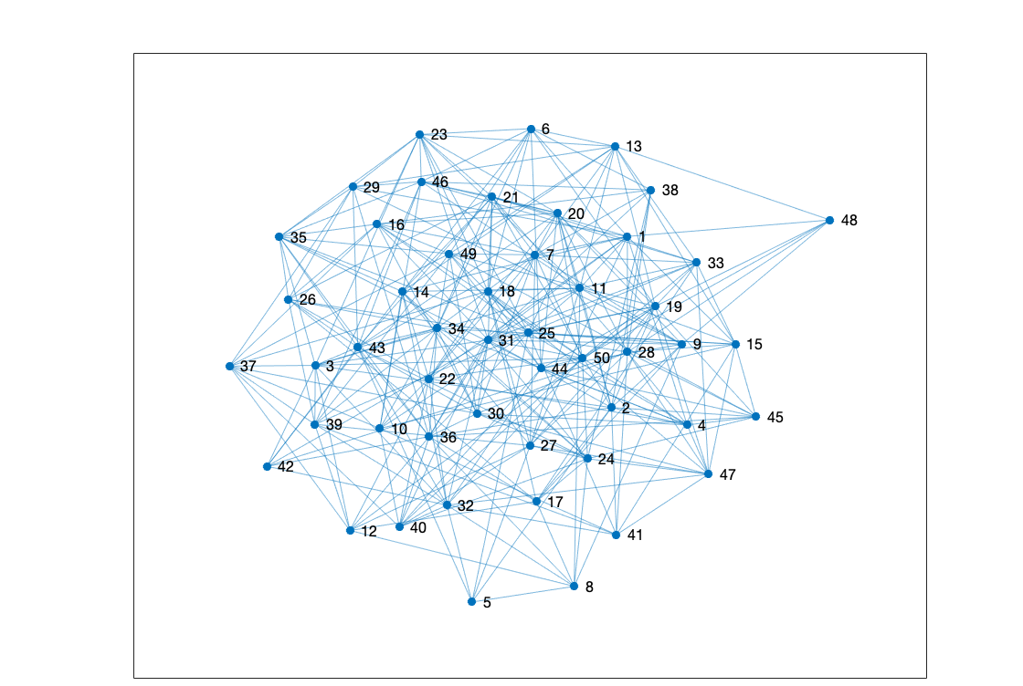
A random 50x50 graph

Slide 61
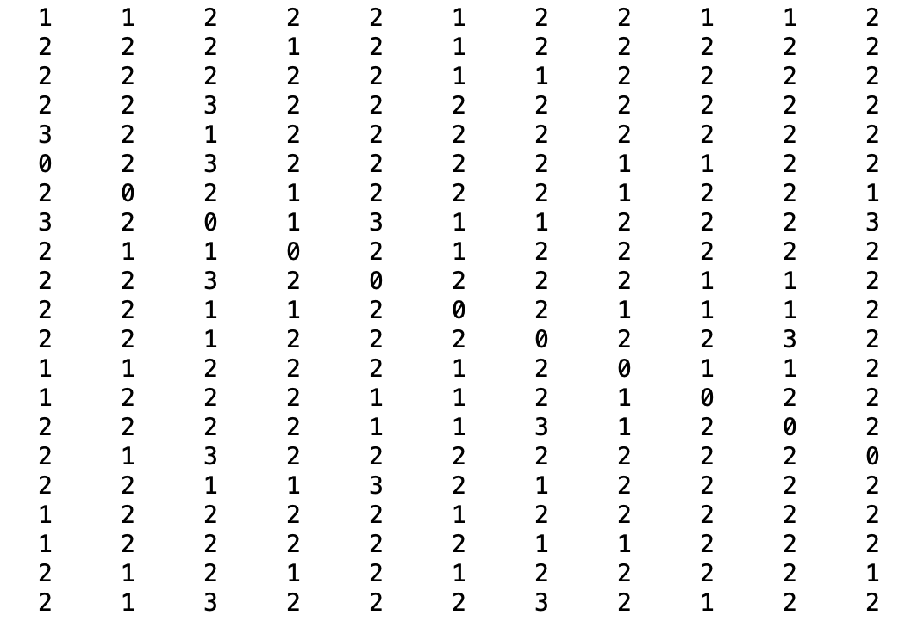
Outcome of Floyd’s Algorithm (partial)

Slide 62
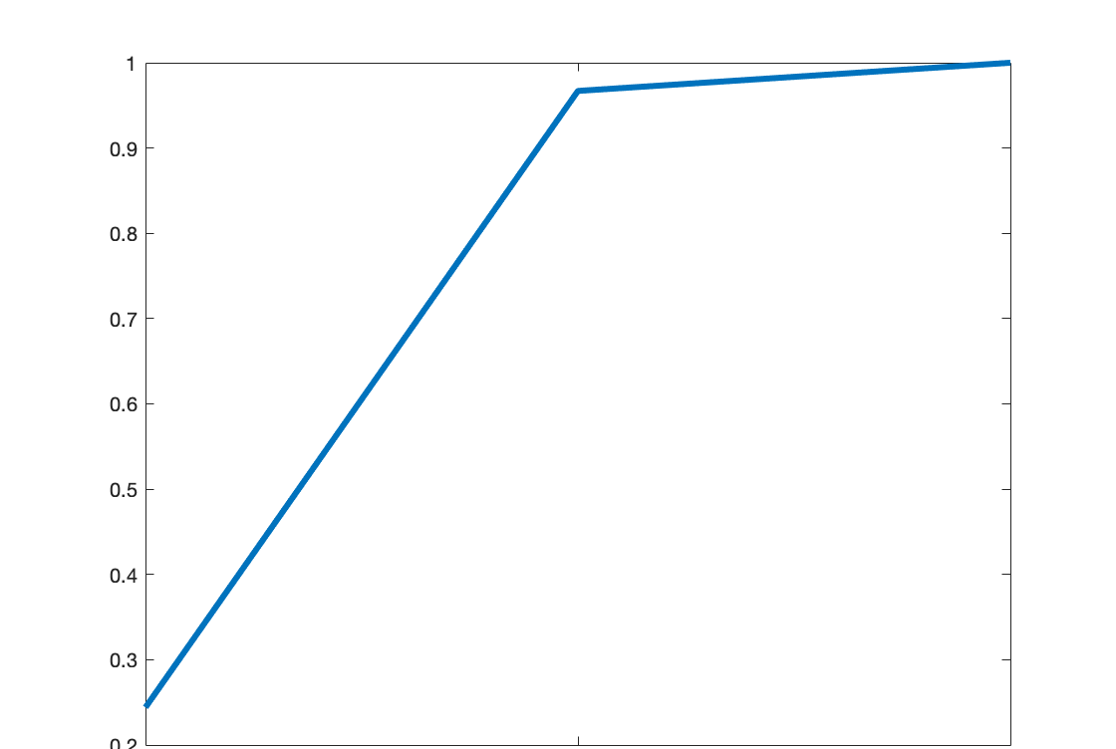
Probability of less than x steps away

Slide 63
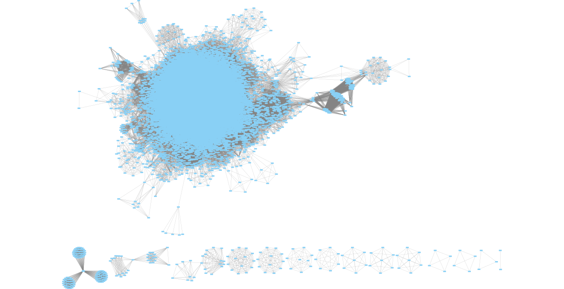
Application of Floyd’s
Graph of who shares a class with whom for Winter 2020

Slide 64
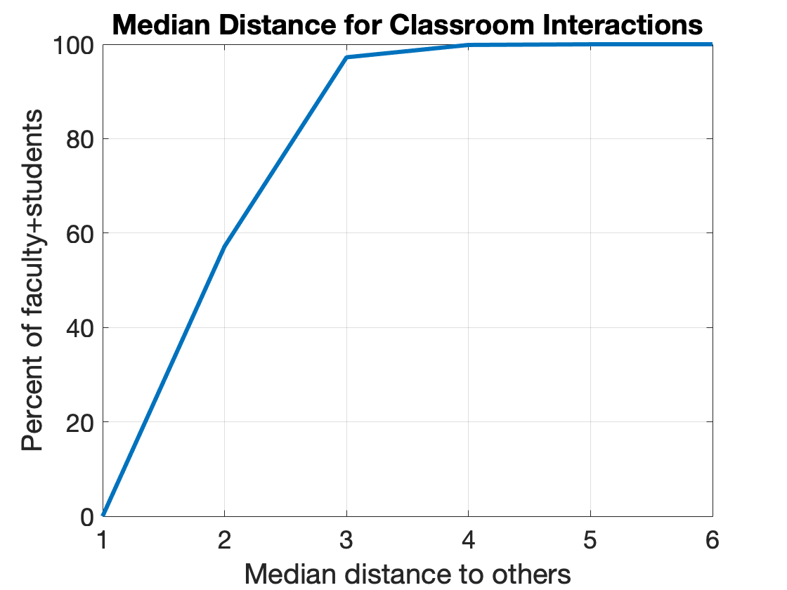
Application of Floyd’s
If infectious, 95% of BYU students and faculty could spread the disease to half the BYU population in three incubation periods

Slide 65
Five Graph Algorithms
Warshall’s algorithm

Slide 66
Segue
Floyd’s algorithm computes the matrix of shortest distances between any two vertices in a directed graph in
  Entry (i,k) in distance matrix is the length of the shortest path between vertex i and vertex k
Warshall’s algorithm computes the matrix representation of the transitive closure of a relation on a set in O(n³)

Slide 67
A very brief review of Transitive Closure

Slide 68
Transitive Closure
Find the smallest R’ that is transitive and that contains R
  • R’ is transitive • R⊆ R’ • ¬∃ R’’ s.t. R⊆ R’’, R’’ is transitive, |R’’|<|R’|
R={(1,2),(2,3),(3,4),(2,1)}
1
2
4
3
Notes:
LaTeX for matrix: \left[ \begin{array}{llll}
& \ \ & \ \ & \ \ \\
& \ \ & \ \ & \ \ \\
& \ \ & \ \ & \ \ \\
& \ \ & \ \ & \ \
\end{array} \right]

Slide 69
Transitive Closure
Methods
Graph
Find the smallest R’ that is transitive and that contains R
  • R’ is transitive • R⊆ R’ • ¬∃ R’’ s.t. R⊆ R’’, R’’ is transitive, |R’’|<|R’|
R={(1,2),(2,3),(3,4),(2,1)} R’={(1,2),(2,3),(3,4),(2,1),(1,3),
(2,4),(1,1),(2,2),(1,4)}
1
2
4
3
Notes:
LaTeX for matrix: \left[ \begin{array}{llll}
& \ \ & \ \ & \ \ \\
& \ \ & \ \ & \ \ \\
& \ \ & \ \ & \ \ \\
& \ \ & \ \ & \ \
\end{array} \right]

Slide 70
Transitive Closure
Methods
Graph
Set
Matrix
Find the smallest R’ that is transitive and that contains R
  • R’ is transitive • R⊆ R’ • ¬∃ R’’ s.t. R⊆ R’’, R’’ is transitive, |R’’|<|R’|
R={(1,2),(2,3),(3,4),(2,1)}
Let R* denote the transitive
closure of R
1
2
4
3
Notes:
LaTeX for matrix: \left[ \begin{array}{llll}
& \ \ & \ \ & \ \ \\
& \ \ & \ \ & \ \ \\
& \ \ & \ \ & \ \ \\
& \ \ & \ \ & \ \
\end{array} \right]

Slide 71
Transitive Closure
Methods
3. Matrix
Find the smallest R’ that is transitive and that contains R
  • R’ is transitive • R⊆ R’ • ¬∃ R’’ s.t. R⊆ R’’, R’’ is transitive, |R’’|<|R’|
R={(1,2),(2,3),(3,4),(2,1)}
M_{R}
M_{R}^{[4]}
M_{R}^{[3]}
any path = one step OR two steps OR three steps OR four steps
Notes:
LaTeX for matrix:
\left[ \begin{array}{llll}
& \ \ & \ \ & \ \ \\
& \ \ & \ \ & \ \ \\
& \ \ & \ \ & \ \ \\
& \ \ & \ \ & \ \
\end{array} \right]

Slide 72
Transitive Closure
Methods
3. Matrix
Find the smallest R’ that is transitive and that contains R
  • R’ is transitive • R⊆ R’ • ¬∃ R’’ s.t. R⊆ R’’, R’’ is transitive, |R’’|<|R’|
R={(1,2),(2,3),(3,4),(2,1)}
M_{R}
M_{R}^{[2]}
M_{R}^{[3]}
M_{R}^{[4]}
any path = one step OR two steps OR three steps OR four steps
Notes:
LaTeX for matrix:
\left[ \begin{array}{llll}
& \ \ & \ \ & \ \ \\
& \ \ & \ \ & \ \ \\
& \ \ & \ \ & \ \ \\
& \ \ & \ \ & \ \
\end{array} \right]

Slide 73
Transitive Closure
Methods
3. Matrix
Find the smallest R’ that is transitive and that contains R
  • R’ is transitive • R⊆ R’ • ¬∃ R’’ s.t. R⊆ R’’, R’’ is transitive, |R’’|<|R’|
R={(1,2),(2,3),(3,4),(2,1)}
M_{R}
M_{R}^{[2]}
M_{R}^{[3]}
M_{R}^{[4]}
Each matrix multiplication is O(n³)
where n is the number of vertices in graph
Notes:
LaTeX for matrix:
\left[ \begin{array}{llll}
& \ \ & \ \ & \ \ \\
& \ \ & \ \ & \ \ \\
& \ \ & \ \ & \ \ \\
& \ \ & \ \ & \ \
\end{array} \right]

Slide 74
Transitive Closure
Methods
3. Matrix
Find the smallest R’ that is transitive and that contains R
  • R’ is transitive • R⊆ R’ • ¬∃ R’’ s.t. R⊆ R’’, R’’ is transitive, |R’’|<|R’|
R={(1,2),(2,3),(3,4),(2,1)}
M_{R}
M_{R}^{[2]}
M_{R}^{[3]}
M_{R}^{[4]}
Each matrix multiplication is O(n³)
where n is the number of vertices in graph.
There are n-1 matrix multiplications: O(n⁴).
Notes:
LaTeX for matrix:
\left[ \begin{array}{llll}
& \ \ & \ \ & \ \ \\
& \ \ & \ \ & \ \ \\
& \ \ & \ \ & \ \ \\
& \ \ & \ \ & \ \
\end{array} \right]

Slide 75
We can do better than O(n⁴)

Slide 76
Warshall’s Algorithm
An O(n³) algorithm for finding the transitive closure
Equivalently, we can think of Warshall’s algorithm as computing the reachability matrix
  The reachability matrix encodes whether vertex j is reachable from vertex k
  A 1 in row j and column k means that there is a path from vertex j to vertex k in the relation’s graph

Slide 77
Warshall’s Algorithm
An O(n³) algorithm for finding the transitive closure
Equivalently, we can think of Warshall’s algorithm as computing the reachability matrix
  The reachability matrix encodes whether vertex j is reachable from vertex k
  A 1 in row j and column k means that there is a path from vertex j to vertex k in the relation’s graph
Algorithm 2 in section 9.4.5 (page 637)
Just Floyd’s algorithm with a different matrix

Slide 78
Warshall’s Algorithm
We’ll see that after k outer loops, w_{ij} = 1 iff there is a path from i to j directly or through {1, 2, …, k}.
1
4
5
1
4
5
3
2
6
3
2
6
Think of M_{R} as a
degenerate weight matrix W
 | 1 | 2 | 3 | 4 | 5 | 6
1 | 0 | 0 | 1 | 0 | 0 | 0
2 | 0 | 0 | 0 | 0 | 0 | 1
3 | 0 | 1 | 1 | 0 | 0 | 0
4 | 1 | 0 | 0 | 0 | 0 | 0
5 | 0 | 0 | 0 | 0 | 0 | 0
6 | 0 | 1 | 0 | 0 | 1 | 0
M_{R} = W

Slide 79
Warshall’s Algorithm
We’ll see that after k outer loops, w_{ij} = 1 iff there is a path from i to j directly or through {1, 2, …, k}.
1
4
5
1
4
5
3
2
6
3
2
6
Initalize
 | 1 | 2 | 3 | 4 | 5 | 6
1 | 0 | 0 | 1 | 0 | 0 | 0
2 | 0 | 0 | 0 | 0 | 0 | 1
3 | 0 | 1 | 1 | 0 | 0 | 0
4 | 1 | 0 | 0 | 0 | 0 | 0
5 | 0 | 0 | 0 | 0 | 0 | 0
6 | 0 | 1 | 0 | 0 | 1 | 0
M_{R} = W
0 means there is not an edge between i and j
1 means there is an edge between i and j

Slide 80
Warshall’s Algorithm
We’ll see that after k outer loops, w_{ij} = 1 iff there is a path from i to j directly or through {1, 2, …, k}.
1
You should be able to initialize this matrix for the final
1
4
5
4
5
3
2
6
3
2
6
Initalize
 | 1 | 2 | 3 | 4 | 5 | 6
1 | 0 | 0 | 1 | 0 | 0 | 0
2 | 0 | 0 | 0 | 0 | 0 | 1
3 | 0 | 1 | 1 | 0 | 0 | 0
4 | 1 | 0 | 0 | 0 | 0 | 0
5 | 0 | 0 | 0 | 0 | 0 | 0
6 | 0 | 1 | 0 | 0 | 1 | 0
M_{R} = W
0 means there is not an edge between i and j
1 means there is an edge between i and j

Slide 81
Warshall’s Algorithm
We’ll see that after k outer loops, w_{ij} = 1 iff there is a path from i to j directly or through {1, 2, …, k}.
1
4
5
1
4
5
3
2
6
3
2
6
Think of M_{R} as a
degenerate weight matrix W
 | 1 | 2 | 3 | 4 | 5 | 6
1 | 0 | 0 | 1 | 0 | 0 | 0
2 | 0 | 0 | 0 | 0 | 0 | 1
3 | 0 | 1 | 1 | 0 | 0 | 0
4 | 1 | 0 | 0 | 0 | 0 | 0
5 | 0 | 0 | 0 | 0 | 0 | 0
6 | 0 | 1 | 0 | 0 | 1 | 0
M_{R} = W
Warshall’s algorithm iteratively
changes 0’s to 1’s in W

Slide 82
Warshall’s Algorithm
You should have this algorithm on your final exam sheet of notes
We’ll see that after k outer loops, w_{ij} = 1 iff there is a path from i to j directly or through {1, 2, …, k}.
Warshall’s algorithm
for (k=1 to n)
for (i=1 to n)
for (j=1 to n)
if (w_{ij} == 0) w_{ij} ← w_{ik} ∧ w_{kj}
 | 1 | 2 | 3 | 4 | 5 | 6
1 | 0 | 0 | 1 | 0 | 0 | 0
2 | 0 | 0 | 0 | 0 | 0 | 1
3 | 0 | 1 | 1 | 0 | 0 | 0
4 | 1 | 0 | 0 | 0 | 0 | 0
5 | 0 | 0 | 0 | 0 | 0 | 0
6 | 0 | 1 | 0 | 0 | 1 | 0
M_{R} = W

Slide 83
Warshall’s Algorithm
We’ll see that after k outer loops, w_{ij} = 1 iff there is a path from i to j directly or through {1, 2, …, k}.
Warshall’s algorithm
1
4
5
1
4
5
for (k=1 to n)
for (i=1 to n)
for (j=1 to n)
if (w_{ij} == 0) w_{ij} ← w_{ik} ∧ w_{kj}
3
2
6
3
2
6
Floyd’s algorithm
for k=1 to n
for i=1 to n
for j=1 to n
if d(v_{i},v_{j}) > d(v_{i},v_{k}) + d(v_{k},v_{j})
then d(v_{i},v_{j}) ← d(v_{i},v_{k}) + d(v_{k},v_{j})
 | 1 | 2 | 3 | 4 | 5 | 6
1 | 0 | 0 | 1 | 0 | 0 | 0
2 | 0 | 0 | 0 | 0 | 0 | 1
3 | 0 | 1 | 1 | 0 | 0 | 0
4 | 1 | 0 | 0 | 0 | 0 | 0
5 | 0 | 0 | 0 | 0 | 0 | 0
6 | 0 | 1 | 0 | 0 | 1 | 0
M_{R} = W

Slide 84
Warshall’s Algorithm
We’ll see that after k outer loops, w_{ij} = 1 iff there is a path from i to j directly or through {1, 2, …, k}.
1
4
5
1
4
5
for (k=1 to n)
for (i=1 to n)
for (j=1 to n)
if (w_{ij} == 0) w_{ij} ← w_{ik} ∧ w_{kj}
3
2
6
3
2
6
Floyd’s algorithm
for k=1 to n
for i=1 to n
for j=1 to n
if d(v_{i},v_{j}) > d(v_{i},v_{k}) + d(v_{k},v_{j})
then d(v_{i},v_{j}) ← d(v_{i},v_{k}) + d(v_{k},v_{j})
 | 1 | 2 | 3 | 4 | 5 | 6
1 | 0 | 0 | 1 | 0 | 0 | 0
2 | 0 | 0 | 0 | 0 | 0 | 1
3 | 0 | 1 | 1 | 0 | 0 | 0
4 | 1 | 0 | 0 | 0 | 0 | 0
5 | 0 | 0 | 0 | 0 | 0 | 0
6 | 0 | 1 | 0 | 0 | 1 | 0
M_{R} = W
textbook says
w_{ij} := w_{ij} ∨ (w_{ik} ∧ w_{kj})
but I’ve written

Slide 85
Warshall’s Algorithm
We’ll see that after k outer loops, w_{ij} = 1 iff there is a path from i to j directly or through {1, 2, …, k}.
1
4
5
1
4
5
for (k=1 to n)
for (i=1 to n)
for (j=1 to n)
if (w_{ij} == 0) w_{ij} ← w_{ik} ∧ w_{kj}
3
2
6
3
2
6
Floyd’s algorithm
for k=1 to n
for i=1 to n
for j=1 to n
if d(v_{i},v_{j}) > d(v_{i},v_{k}) + d(v_{k},v_{j})
then d(v_{i},v_{j}) ← d(v_{i},v_{k}) + d(v_{k},v_{j})
 | 1 | 2 | 3 | 4 | 5 | 6
1 | 0 | 0 | 1 | 0 | 0 | 0
2 | 0 | 0 | 0 | 0 | 0 | 1
3 | 0 | 1 | 1 | 0 | 0 | 0
4 | 1 | 0 | 0 | 0 | 0 | 0
5 | 0 | 0 | 0 | 0 | 0 | 0
6 | 0 | 1 | 0 | 0 | 1 | 0
M_{R} = W
textbook says
w_{ij} := w_{ij} ∨ (w_{ik} ∧ w_{kj})
but I’ve written

Slide 86
Warshall’s Algorithm
We’ll see that after k outer loops, w_{ij} = 1 iff there is a path from i to j directly or through {1, 2, …, k}.
1
4
5
1
4
5
for (k=1 to n)
for (i=1 to n)
for (j=1 to n)
if (w_{ij} == 0) w_{ij} ← w_{ik} ∧ w_{kj}
3
2
6
3
2
6
 | 1 | 2 | 3 | 4 | 5 | 6
1 | 0 | 0 | 1 | 0 | 0 | 0
2 | 0 | 0 | 0 | 0 | 0 | 1
3 | 0 | 1 | 1 | 0 | 0 | 0
4 | 1 | 0 | 0 | 0 | 0 | 0
5 | 0 | 0 | 0 | 0 | 0 | 0
6 | 0 | 1 | 0 | 0 | 1 | 0
M_{R} = W
w_{ij} := w_{ij} ∨ (w_{ik} ∧ w_{kj})
If w_{ij} == 0 replace it with w_{ik} ∧ w_{kj}
If w_{ij} == 1 don’t change it

Slide 87
Warshall’s Algorithm
We’ll see that after k outer loops, w_{ij} = 1 iff there is a path from i to j directly or through {1, 2, …, k}.
1
4
5
1
4
5
for (k=1 to n)
for (i=1 to n)
for (j=1 to n)
if (w_{ij} == 0) w_{ij} ← w_{ik} ∧ w_{kj}
3
2
6
3
2
6
 | 1 | 2 | 3 | 4 | 5 | 6
1 | 0 | 0 | 1 | 0 | 0 | 0
2 | 0 | 0 | 0 | 0 | 0 | 1
3 | 0 | 1 | 1 | 0 | 0 | 0
4 | 1 | 0 | 0 | 0 | 0 | 0
5 | 0 | 0 | 0 | 0 | 0 | 0
6 | 0 | 1 | 0 | 0 | 1 | 0
M_{R} = W
w_{ij} is 1 if there is a path from i to j

Slide 88
Warshall’s Algorithm
We’ll see that after k outer loops, w_{ij} = 1 iff there is a path from i to j directly or through {1, 2, …, k}.
1
4
5
1
4
5
for (k=1 to n)
for (i=1 to n)
for (j=1 to n)
if (w_{ij} == 0) w_{ij} ← w_{ik} ∧ w_{kj}
3
2
6
3
2
6
k is called a pivot
 | 1 | 2 | 3 | 4 | 5 | 6
1 | 0 | 0 | 1 | 0 | 0 | 0
2 | 0 | 0 | 0 | 0 | 0 | 1
3 | 0 | 1 | 1 | 0 | 0 | 0
4 | 1 | 0 | 0 | 0 | 0 | 0
5 | 0 | 0 | 0 | 0 | 0 | 0
6 | 0 | 1 | 0 | 0 | 1 | 0
M_{R} = W
w_{ij} is 1 if there is a path from i to j

Slide 89
Warshall’s Algorithm
We’ll see that after k outer loops, w_{ij} = 1 iff there is a path from i to j directly or through {1, 2, …, k}.
1
4
5
1
4
5
for (k=1 to n)
for (i=1 to n)
for (j=1 to n)
if (w_{ij} == 0) w_{ij} ← w_{ik} ∧ w_{kj}
3
2
6
3
2
6
k is called a pivot
 | 1 | 2 | 3 | 4 | 5 | 6
1 | 0 | 0 | 1 | 0 | 0 | 0
2 | 0 | 0 | 0 | 0 | 0 | 1
3 | 0 | 1 | 1 | 0 | 0 | 0
4 | 1 | 0 | 0 | 0 | 0 | 0
5 | 0 | 0 | 0 | 0 | 0 | 0
6 | 0 | 1 | 0 | 0 | 1 | 0
M_{R} = W
w_{ij} is 1 if there is a path from i to j
Is there a path from i to j through the pivot:
path from i to k AND path from k to j

Slide 90
Warshall’s Algorithm
We’ll see that after k outer loops, w_{ij} = 1 iff there is a path from i to j directly or through {1, 2, …, k}.
1
You should be able answer questions about this matrix for the final
1
4
5
4
5
for (k=1 to n)
for (i=1 to n)
for (j=1 to n)
if (w_{ij} == 0) w_{ij} ← w_{ik} ∧ w_{kj}
3
2
6
3
2
6
Try a pivot
Add a direct edge
for all i and j
 | 1 | 2 | 3 | 4 | 5 | 6
1 | 0 | 0 | 1 | 0 | 0 | 0
2 | 0 | 0 | 0 | 0 | 0 | 1
3 | 0 | 1 | 1 | 0 | 0 | 0
4 | 1 | 0 | 0 | 0 | 0 | 0
5 | 0 | 0 | 0 | 0 | 0 | 0
6 | 0 | 1 | 0 | 0 | 1 | 0
M_{R} = W

Slide 91
Warshall’s Algorithm
We’ll see that after k outer loops, w_{ij} = 1 iff there is a path from i to j directly or through {1, 2, …, k}.
1
4
5
1
4
5
for (k=1 to n)
for (i=1 to n)
for (j=1 to n)
if (w_{ij} == 0) w_{ij} ← w_{ik} ∧ w_{kj}
3
2
6
3
2
6
Try a pivot
Add a direct edge
for all i and j
 | 1 | 2 | 3 | 4 | 5 | 6
1 | 0 | 0 | 1 | 0 | 0 | 0
2 | 0 | 0 | 0 | 0 | 0 | 1
3 | 0 | 1 | 1 | 0 | 0 | 0
4 | 1 | 0 | 0 | 0 | 0 | 0
5 | 0 | 0 | 0 | 0 | 0 | 0
6 | 0 | 1 | 0 | 0 | 1 | 0
M_{R} = W

Slide 92
Warshall’s Algorithm
We’ll see that after k outer loops, w_{ij} = 1 iff there is a path from i to j directly or through {1, 2, …, k}.
1
4
5
1
4
5
for (k=1 to n)
for (i=1 to n)
for (j=1 to n)
if (w_{ij} == 0) w_{ij} ← w_{ik} ∧ w_{kj}
3
2
6
3
2
6
 | 1 | 2 | 3 | 4 | 5 | 6
1 | 0 | 0 | 1 | 0 | 0 | 0
2 | 0 | 0 | 0 | 0 | 0 | 1
3 | 0 | 1 | 1 | 0 | 0 | 0
4 | 1 | 0 | 0 | 0 | 0 | 0
5 | 0 | 0 | 0 | 0 | 0 | 0
6 | 0 | 1 | 0 | 0 | 1 | 0
M_{R} = W
View in presentation mode so that you can see the animations

Slide 93
Warshall’s Algorithm
We’ll see that after k outer loops, w_{ij} = 1 iff there is a path from i to j directly or through {1, 2, …, k}.
1
4
5
1
4
5
for (k=1 to n)
for (i=1 to n)
for (j=1 to n)
if (w_{ij} == 0) w_{ij} ← w_{ik} ∧ w_{kj}
3
2
6
3
2
6
k=1: w₄₁ ∧ w₁₃ adds (4,3)
k=2: w₃₂ ∧ w₂₆ adds (3,6),
w₆₂ ∧ w₂₆ adds (6,6)
 | 1 | 2 | 3 | 4 | 5 | 6
1 | 0 | 0 | 1 | 0 | 0 | 0
2 | 0 | 0 | 0 | 0 | 0 | 1
3 | 0 | 1 | 1 | 0 | 0 | 0
4 | 1 | 0 | 0 | 0 | 0 | 0
5 | 0 | 0 | 0 | 0 | 0 | 0
6 | 0 | 1 | 0 | 0 | 1 | 0
M_{R} = W
1
1
1
k=3: w₁₃ ∧ w₃₂ adds (1,2),
w₄₃ ∧ w₃₂ adds (4,2),
w₄₃ ∧ w₃₆ adds (4,6),
w₁₃ ∧ w₃₆ adds (1,6)
1
1
1
1
1
1
1
1
k=4 and k=5 add nothing (either no in or no out)
k=6: adds (2,5), (3,5), (1,5), (4,5), (2,2)
1

Slide 94
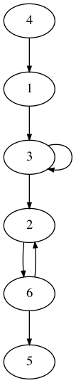
Warshall’s Algorithm
 | 1 | 2 | 3 | 4 | 5 | 6
1 | 0 | 0 | 1 | 0 | 0 | 0
2 | 0 | 0 | 0 | 0 | 0 | 1
3 | 0 | 1 | 1 | 0 | 0 | 0
4 | 1 | 0 | 0 | 0 | 0 | 0
5 | 0 | 0 | 0 | 0 | 0 | 0
6 | 0 | 1 | 0 | 0 | 1 | 0
Closure
graph
Original
graph
Computes the transitive closure in O(n³)

Slide 95
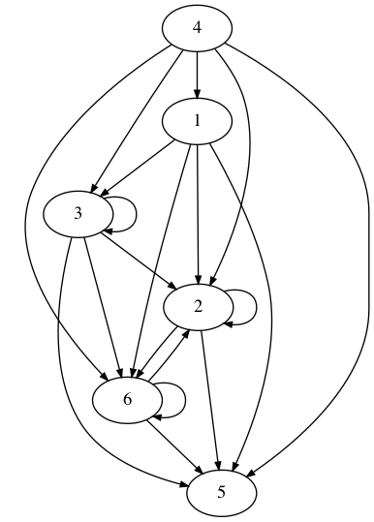
Warshall’s Algorithm
 | 1 | 2 | 3 | 4 | 5 | 6
1 | 0 | 0 | 1 | 0 | 0 | 0
2 | 0 | 0 | 0 | 0 | 0 | 1
3 | 0 | 1 | 1 | 0 | 0 | 0
4 | 1 | 0 | 0 | 0 | 0 | 0
5 | 0 | 0 | 0 | 0 | 0 | 0
6 | 0 | 1 | 0 | 0 | 1 | 0
Closure
graph
Original
graph
 | 1 | 2 | 3 | 4 | 5 | 6
1 | 0 | 1 | 1 | 0 | 1 | 1
2 | 0 | 1 | 0 | 0 | 1 | 1
3 | 0 | 1 | 1 | 0 | 1 | 1
4 | 1 | 1 | 1 | 0 | 1 | 1
5 | 0 | 0 | 0 | 0 | 0 | 0
6 | 0 | 1 | 0 | 0 | 1 | 1

Slide 96
Warshall’s Algorithm
We’ll see that after k outer loops, w_{ij} = 1 iff there is a path from i to j directly or through {1, 2, …, k}.
1
4
5
1
4
5
for (k=1 to n)
for (i=1 to n)
for (j=1 to n)
if (w_{ij} == 0) w_{ij} ← w_{ik} ∧ w_{kj}
3
2
6
3
2
6
 | 1 | 2 | 3 | 4 | 5 | 6
1 | 0 | 1 | 1 | 0 | 1 | 1
2 | 0 | 1 | 0 | 0 | 1 | 1
3 | 0 | 1 | 1 | 0 | 1 | 1
4 | 1 | 1 | 1 | 0 | 1 | 1
5 | 0 | 0 | 0 | 0 | 0 | 0
6 | 0 | 1 | 0 | 0 | 1 | 1
Paragraph after Alg 2 in section 9.4.2 shows that
the algorithm is O(n³)

Slide 97
Induction Proof for Floyd’s Algorithm
Optional – we won’t discuss the proof or give a test question about the proof

Slide 98
Proof that Floyd’s Algorithm Works
Termination: Clear (can map each loop to a descending sequence on a well-founded poset)
Loop Invariant
  What does the algorithm do?
  After k outer loops, each Dist[i,j] is as short or shorter than any other path from i to j whose intermediate nodes are in {1, …, k}.
Proof (why does it work?):
  Basis: k=0, no intermediate nodes; initialized to the shortest path with no intermediate nodes.
  Induction: We need to prove S(k) ⇒ S(k+1), where S(k) is the loop invariant.

Slide 99
Induction Part of the Proof
Assume after k iterations, each Dist[i,j] is as short or shorter than any other path from i to j whose intermediate nodes are in {1, …, k}.
There are two cases for the k+1st iteration.
  Case 1: Dist[i,j] > Dist[i,k+1] + Dist[k+1,j]. The new distance is Dist[i,k+1] + Dist[k+1,j], which is shorter than the previous distance, and thus by the induction hypothesis is as short or shorter than any other path from i to j whose intermediate nodes are in {1, …, k+1}.
  Case 2: Dist[i,j] ≤ Dist[i,k+1] + Dist[k+1,j]. The current path is as short or shorter and left unchanged, and thus by the induction hypothesis is as short or shorter than any other path from i to j whose intermediate nodes are in {1, …, k+1}.

